Slide 1
Rotor mmf
The polyphase winding of the rotor carries a polyphase current.
Thus the rotor also produces a rotating field.
The rotor and stator magnetic axes move at the same speed (with respect to the stator) and in the same direction (Were it not so, the machine would not be self-maintaining in rotation).

Slide 2
Rotor mmf cont’d
The stator and rotor windings must be arranged to have the same number of poles, so that their mmf waves can combine to form a resultant rotating mmf wave.
A wound-rotor would therefore have to be wound to have the same number of poles as the stator.

Slide 3
Rotor mmf cont’d
The cage winding has the advantage of adapting itself readily to any number of the stator poles
A squirrel cage can be viewed as a polyphase winding.
Generally with C individual rotor conductors, one per slot, the number of rotor phases is m = C/2p.

Slide 4
Rotor mmf cont’d
Single turns constitute the windings of each phase.
The number of poles of the rotor is entirely determined by the stator.

Slide 5
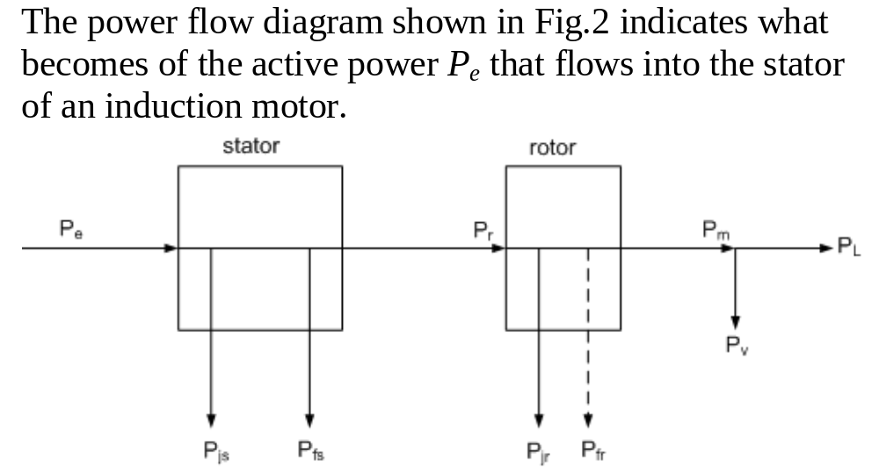
Active power flow through induction motor

Slide 6
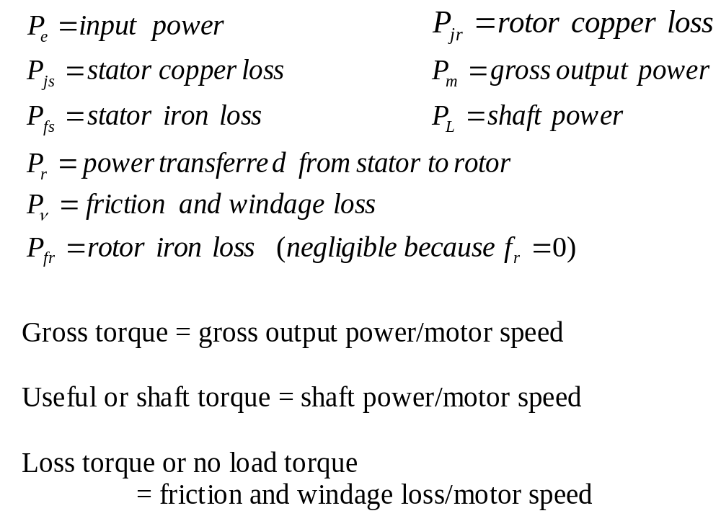

Slide 7
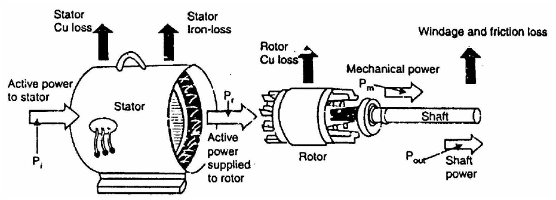
Active power flow through induction motor cont’d

Slide 8
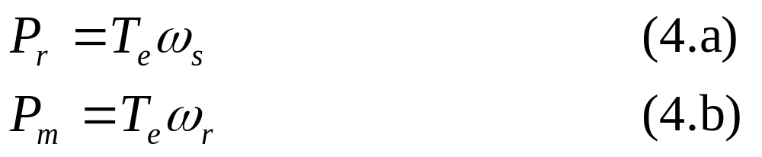
Torque and output power equations
The power transferred from the stator to the rotor and the gross mechanical power are given by
where T_{e} is the electromagnetic or gross torque developed by the motor.

Slide 9
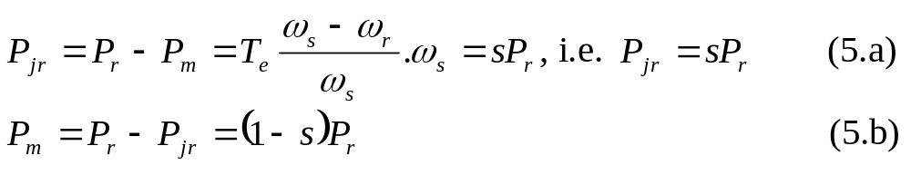
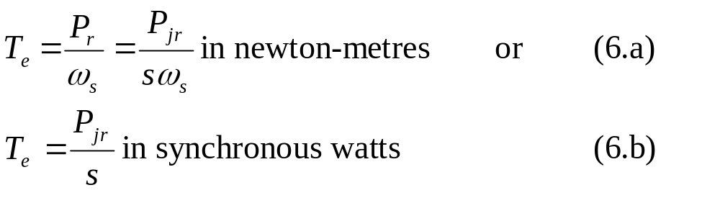
Torque and output power equations
If the rotor iron loss is neglected then
Also the gross or electromagnetic torque

Slide 10
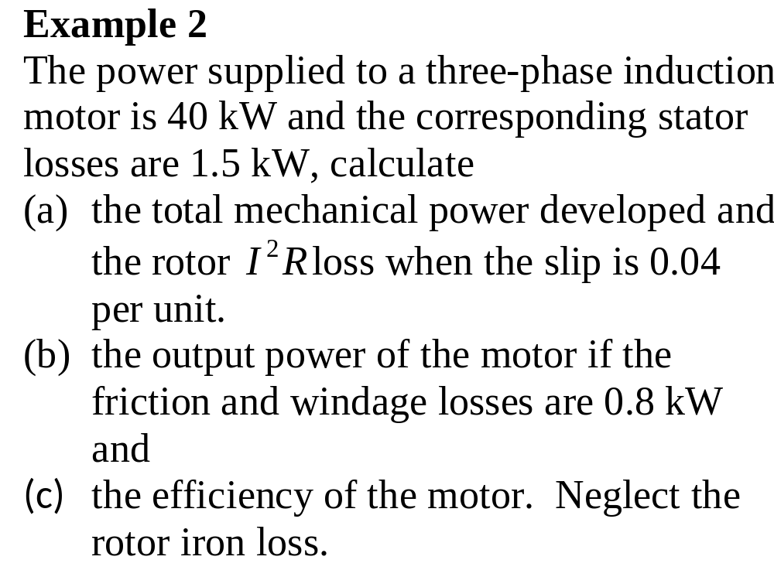

Slide 11
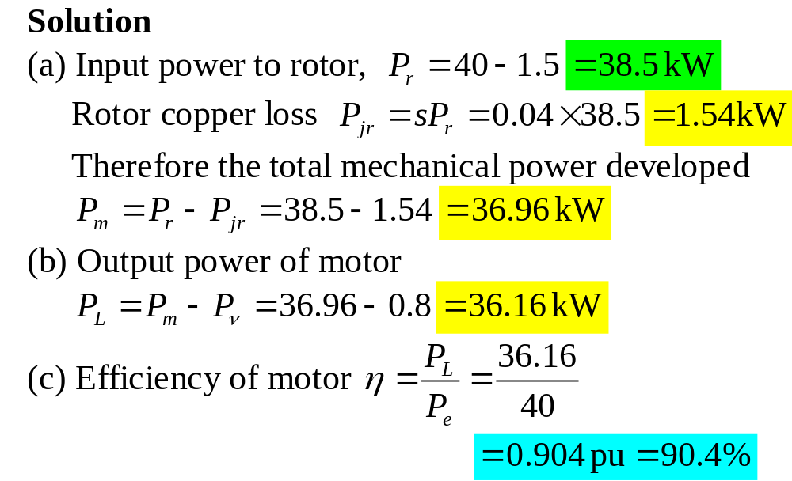

Slide 12
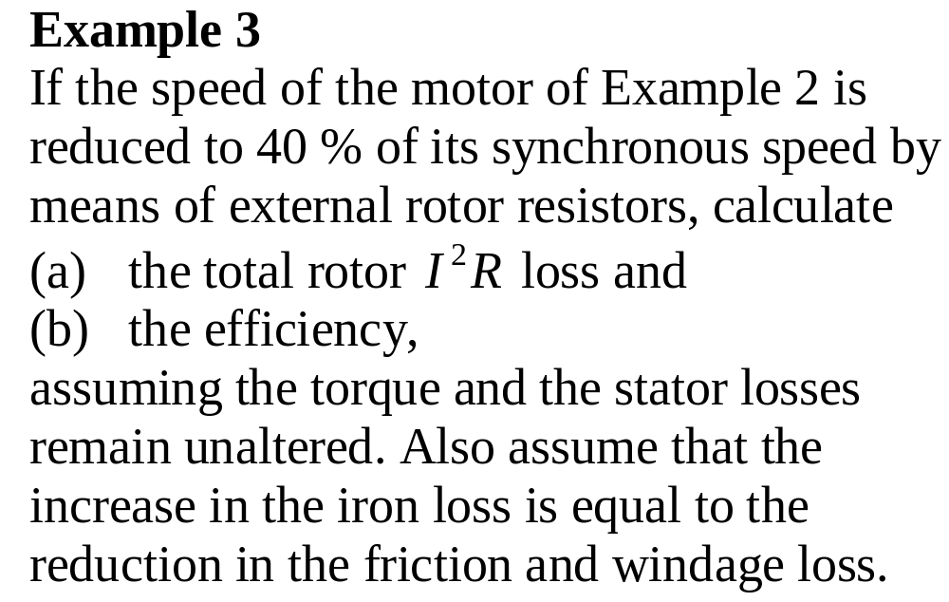

Slide 13
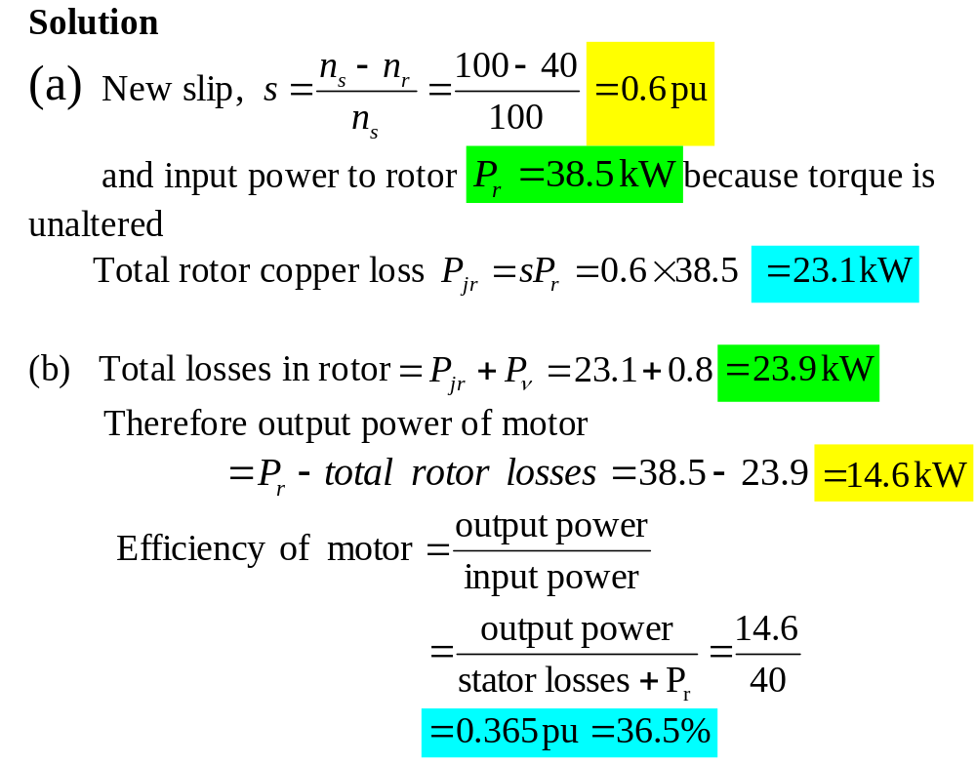

Slide 14
Stator and rotor induced voltages
Conditions with rotor winding stationary and open-circuited
When a voltage is applied to the stator, it takes current which produces a rotating mmf.
The stator rotating mmf then produces a rotating flux.

Slide 15
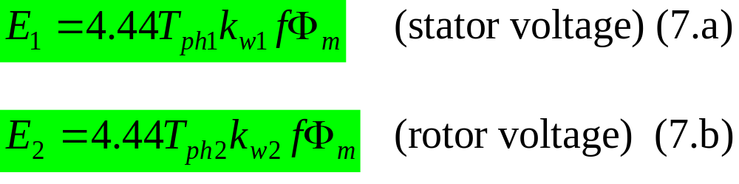
Conditions with rotor winding stationary and open-circuited cont’d
A major part of the flux links the rotor and the remainder is a leakage flux.
The mutual flux induces phase voltages:

Slide 16
Rotor winding closed
When the rotor winding is closed, the voltage induced in the rotor by the mutual flux causes current to circulate.
Whether the rotor is locked or released, the mmf of the rotor rotating also at synchronous speed, tend to demagnetize the machine, so that the stator takes equal and opposite mmf component as in transformers.

Slide 17
Stator and rotor induced voltages
Rotor winding closed cont’d
There is established a rotor leakage flux, a reduced mutual flux and an increased stator leakage flux.

Slide 18
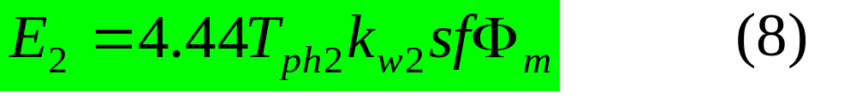
Rotor winding closed cont’d
With the rotor released (the general case) the induced emf in the rotor becomes:
At standstill s = 1 and the induced emf is given by (7.b).
However, the mutual flux is very small.
The mutual flux in the equation is about 50 % of no load value

Slide 19
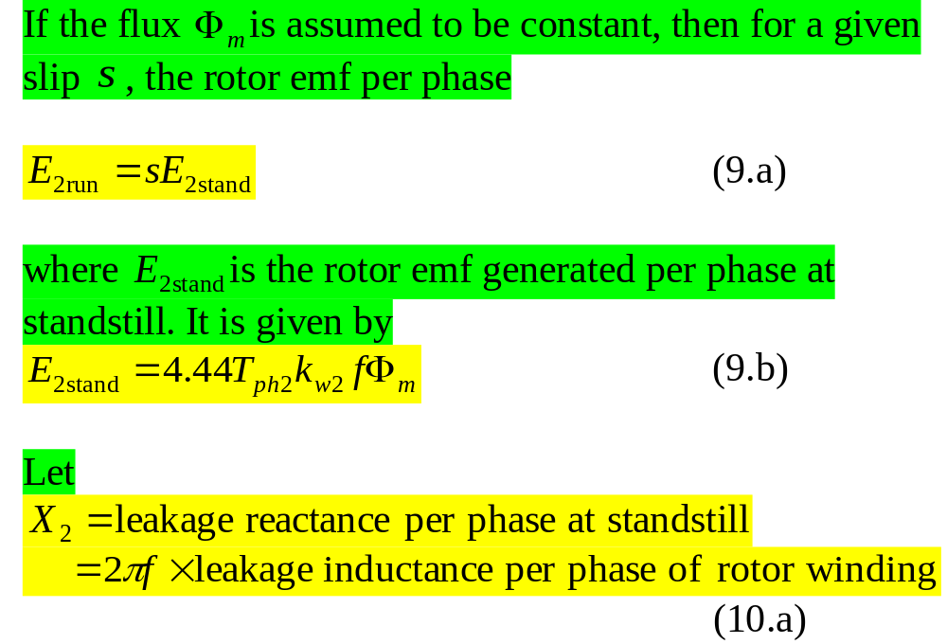
Torque calculations assuming constant mutual flux

Slide 20
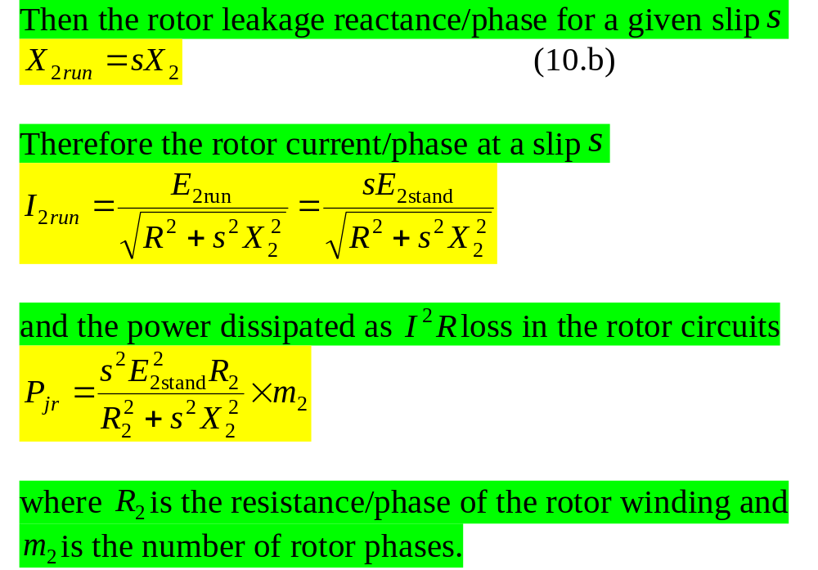
Torque calculations assuming constant mutual flux

Slide 21
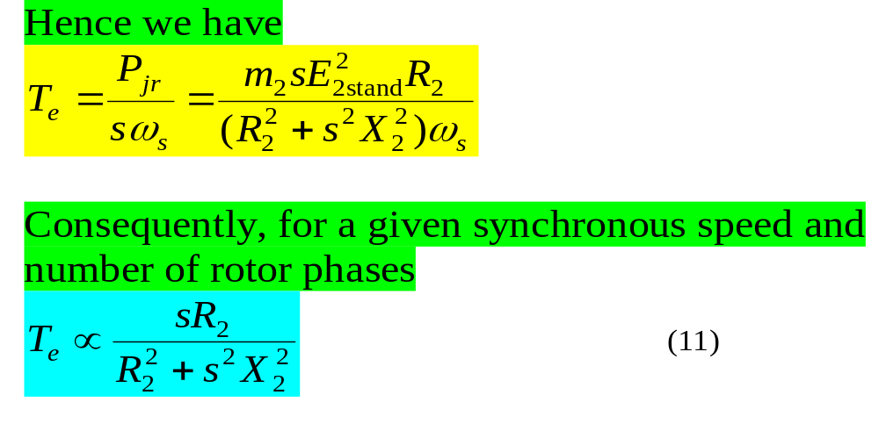
Torque calculations assuming constant mutual flux

Slide 22
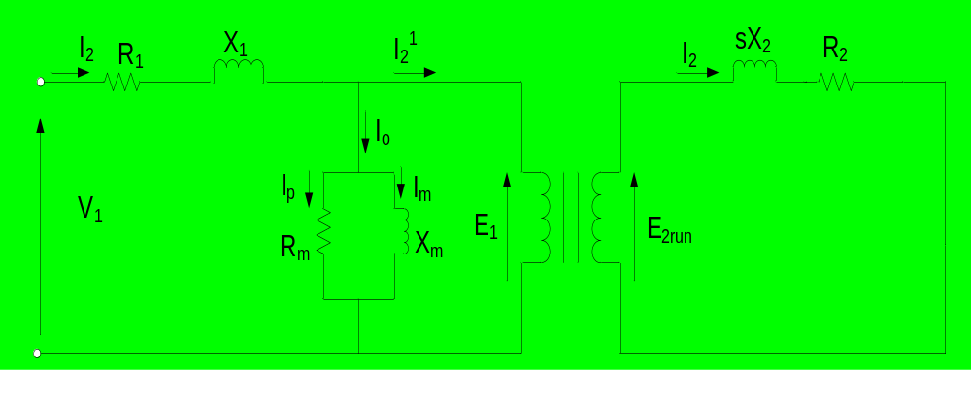
Exact equivalent circuit
The equivalent circuit is arrived at in the same way as for transformer.
The circuit on the single-phase or per phase basis is

Slide 23
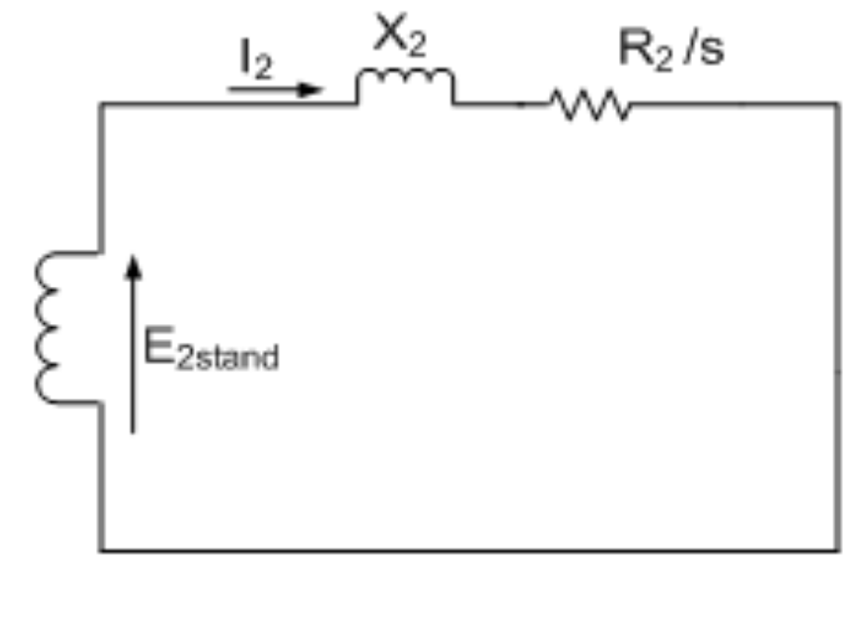
Exact equivalent circuit cont’d
The rotor circuit can be redrawn as
The significance of this rotor circuit is that it represents the rotating rotor by a fictitious stationary rotor with a constant reactance (or frequency) but with a variable resistance.

Slide 24
Exact equivalent circuit cont’d
This fictitious stationary rotor carries the same current as the actual rotor, and thus, it produces the same mmf wave.
With the rotor represented this way, it is now possible to transfer the secondary (rotor) impedance to the primary (stator) side in the same way as for transformer with the secondary short-circuited.

Slide 25
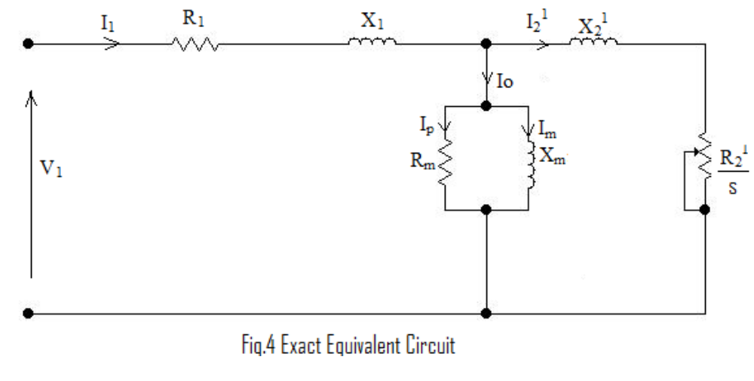
Exact equivalent circuit cont’d
The equivalent circuit referred to the stator is

Slide 26
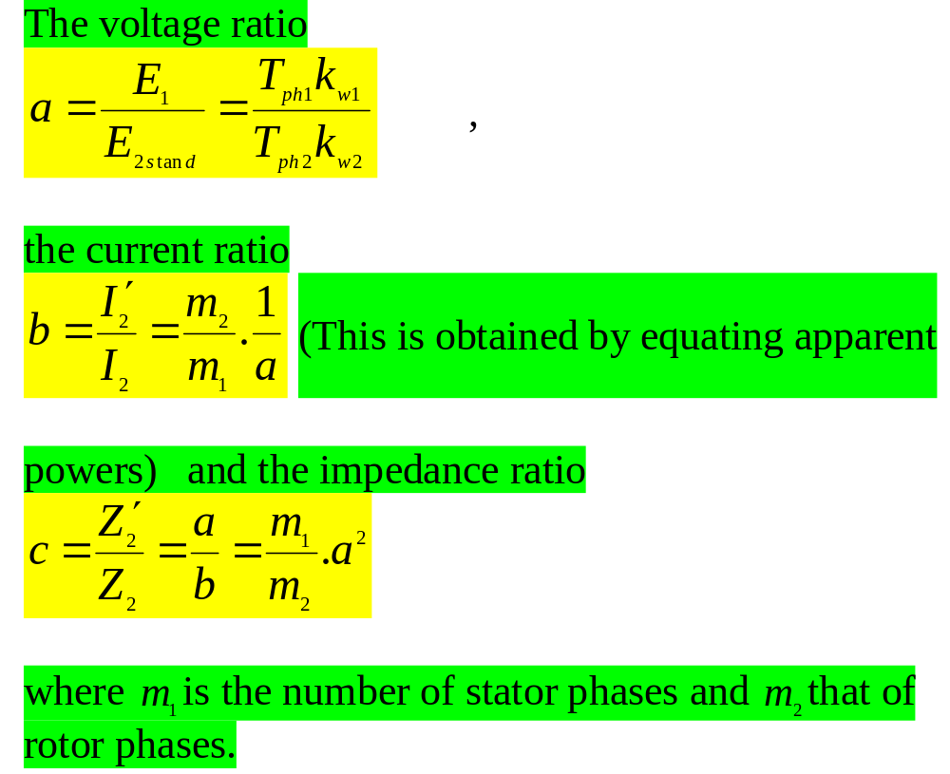

Slide 27
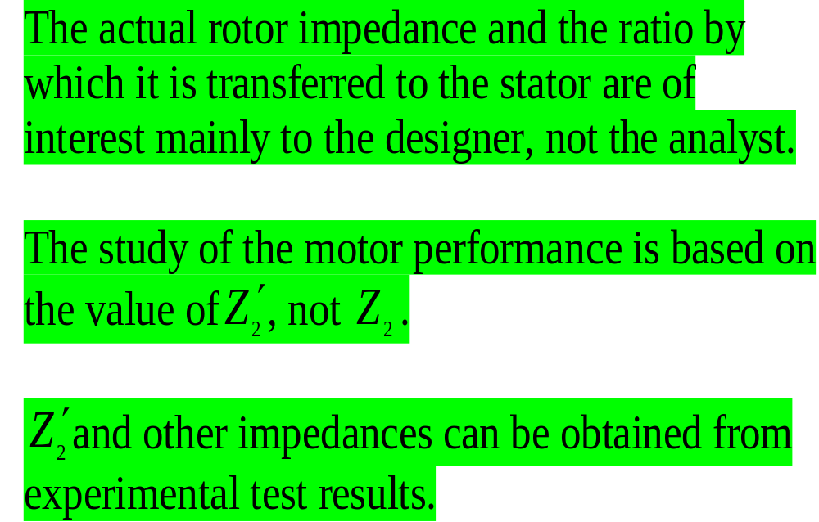
Exact equivalent circuit cont’d

